Slide 1
Group Assignment: Secure Data Storage and Encryption using Gnupg
Group Members:
Ishan Prabhune
Harshal Sawant
Pratik Darade
Aniket Singh
Raj Dedhia

Slide 2
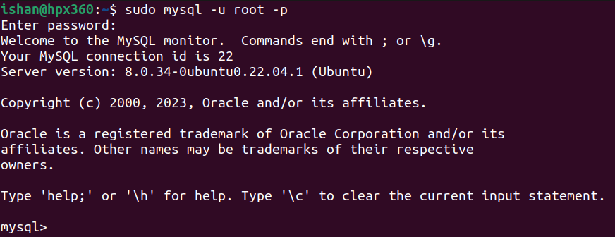
Task1: Database Design and Setup
Enter MySQL
sudo mysql -u root -p

Slide 3
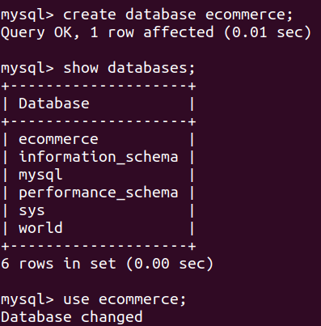
Create database Ecommerce
We have created database ecommerce.
And we can see tables in the database using “show databases” command.

Slide 4
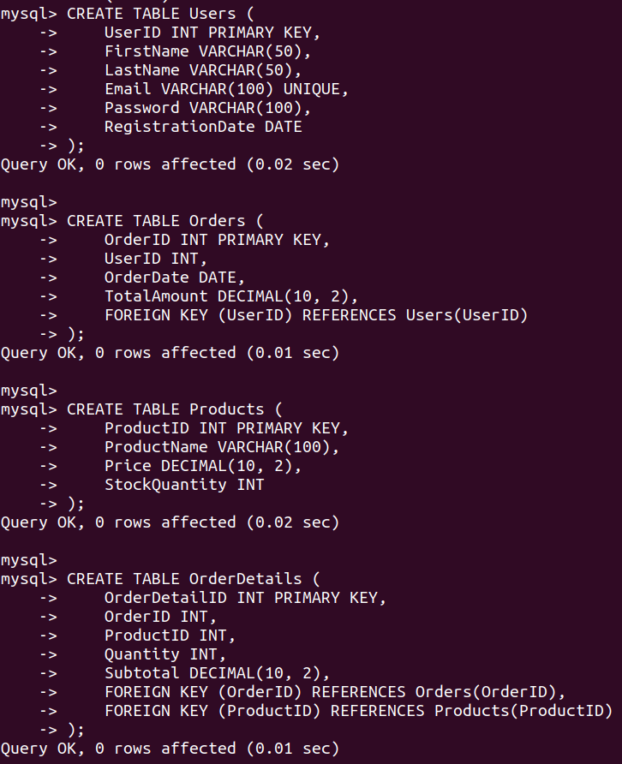
Now we create tables.
The tables are- Users, Orders, Products and OrderDetails.

Slide 5
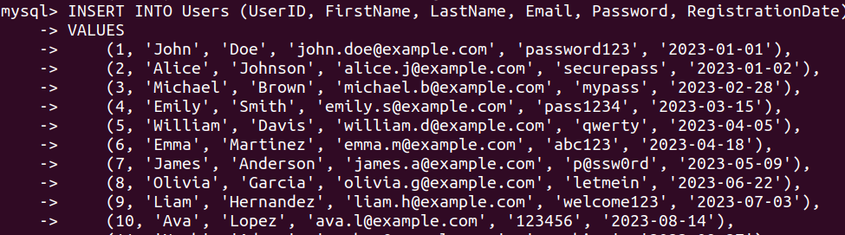
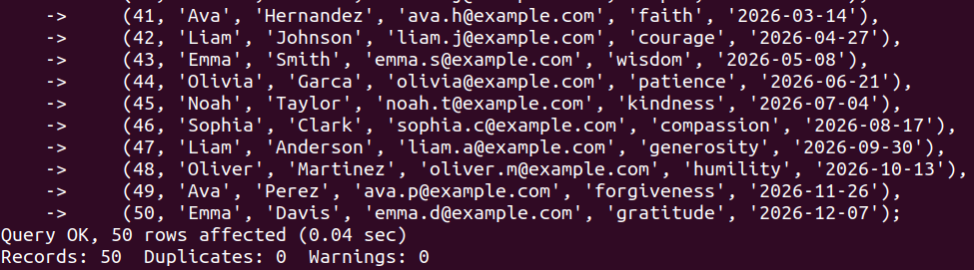
Task2: Secure Data Storage Populating table Users
We have populated Table Users here.

Slide 6
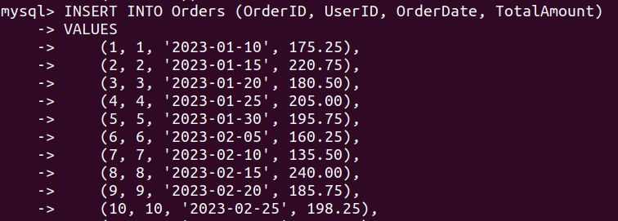
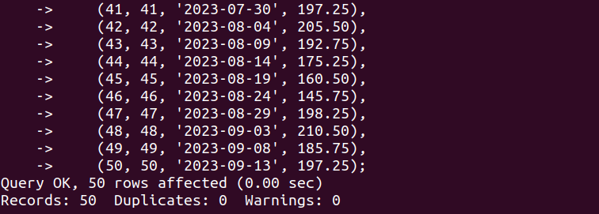
Populating table Orders
We have populated Table Orders here.

Slide 7
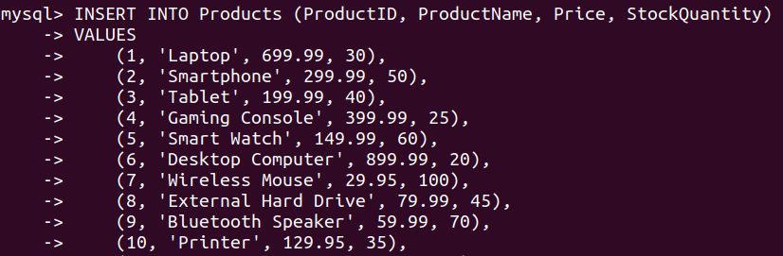
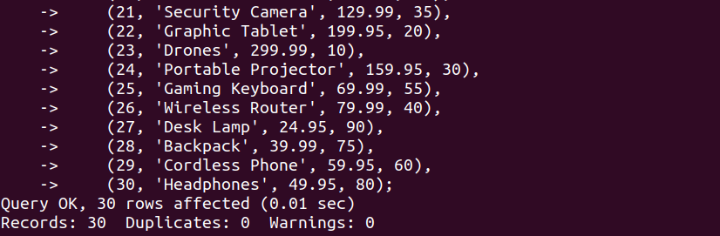
Populating table PRODUCTS
We have populated Table Products here.

Slide 8
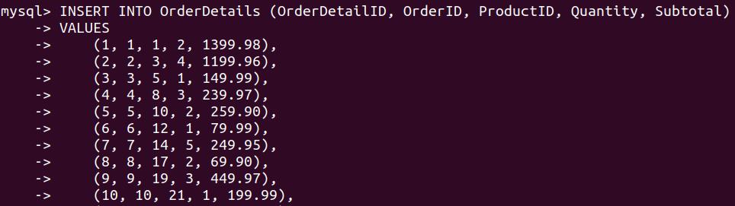
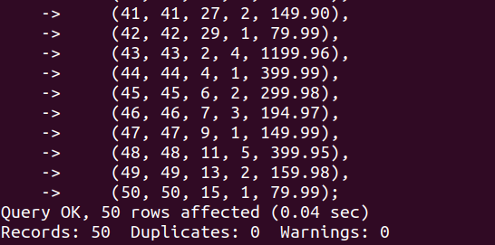
Populating table ORDERDETAILS
We have populated Table OrderDetails here.

Slide 9
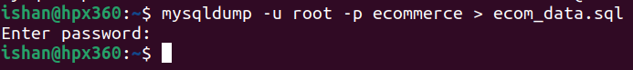
Exporting table data
Now we export the table data.

Slide 10
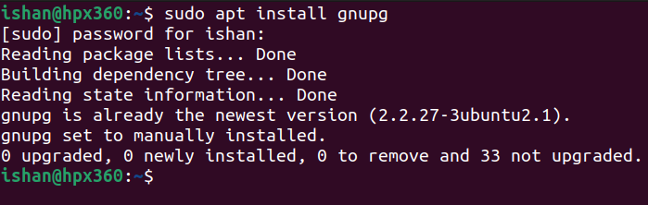
Task 3: Encryption using GnuPG
Installing GnuPG on our machine.

Slide 11
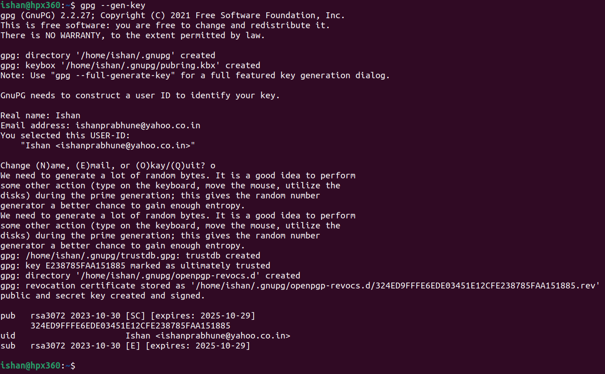
Displaying the keys of Gnupg
To display the keys in GnuPG (GNU Privacy Guard) on the command line, you can use the gpg command with the --gen-key

Slide 12
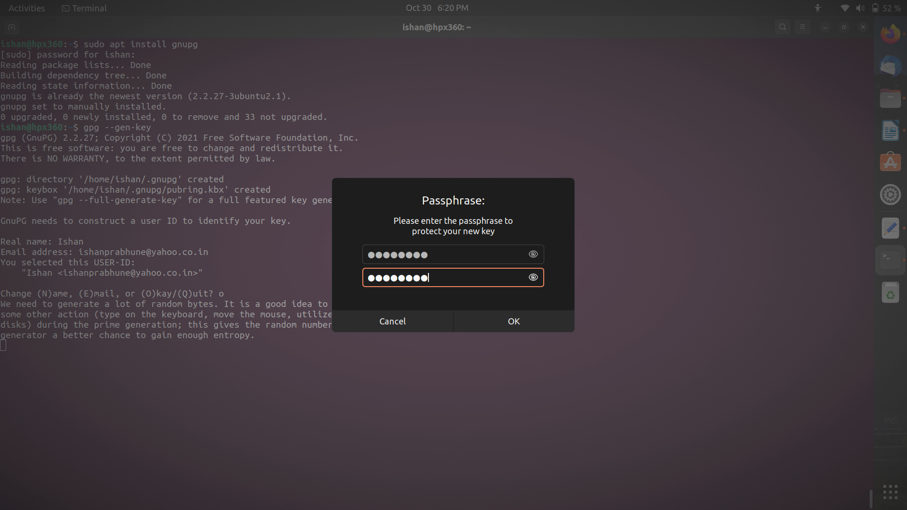
setting a password for gnupg

Slide 13
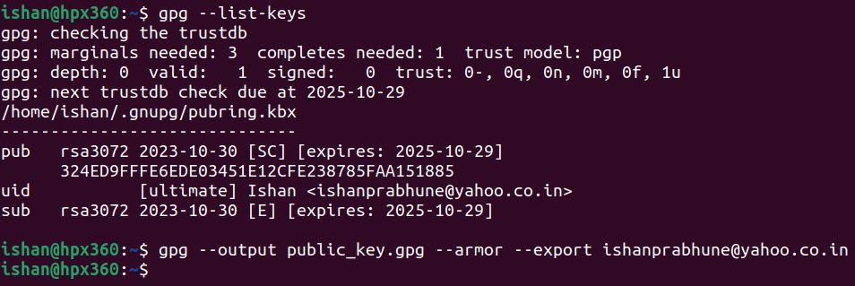
Listing keys and exporting our key
Listing the keys and exporting our key using command gpg --list-keys and gpg --output public_key.gpg --armor -- export mailid

Slide 14
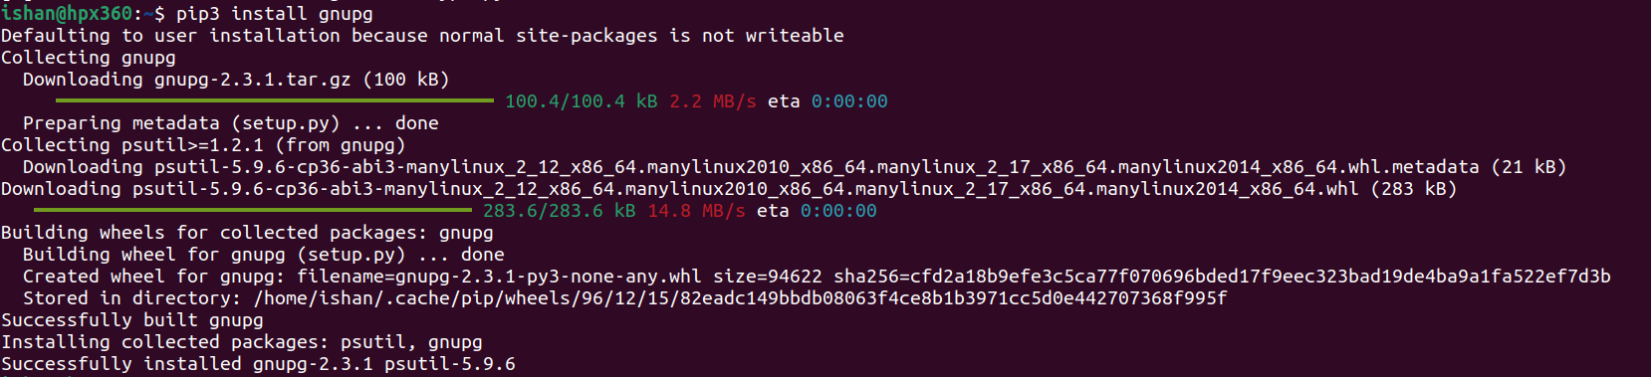
installing GnuPG for python pip
Installing gnupg for python pip using command pip3 install gnupg

Slide 15
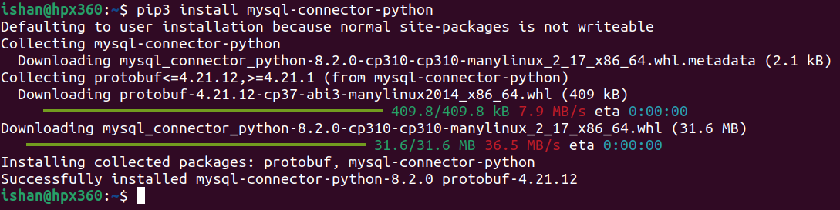
installing mysql connector
Installing mysql connector using command pip3 install mysql -connector -phython

Slide 16
encrypting entire file using GnuPG
Encrypting entire file using GnuPG using command gpg –e –r mailid in ecom_data.sql

Slide 17
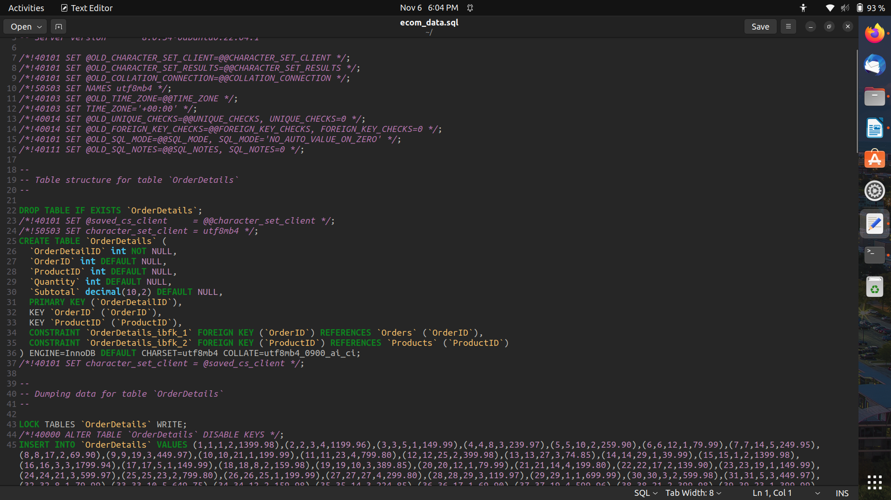
File before encrypting
File snapshot before performing encryption.

Slide 18
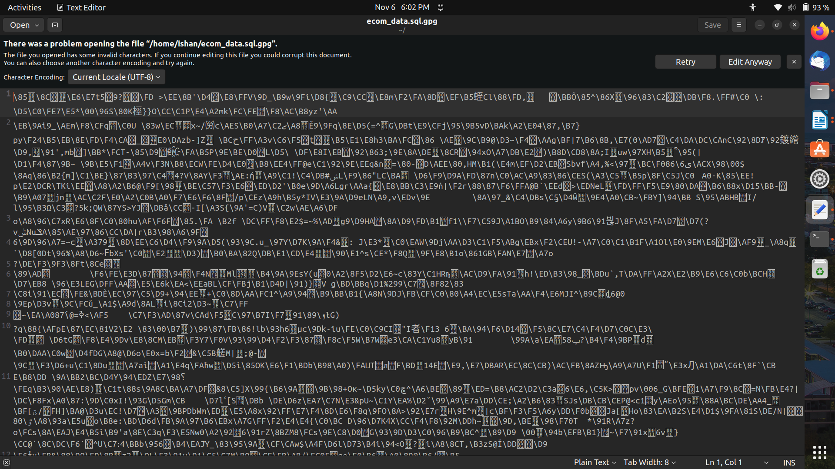
File after encrypting
File snapshot after performing encrypting.

Slide 19
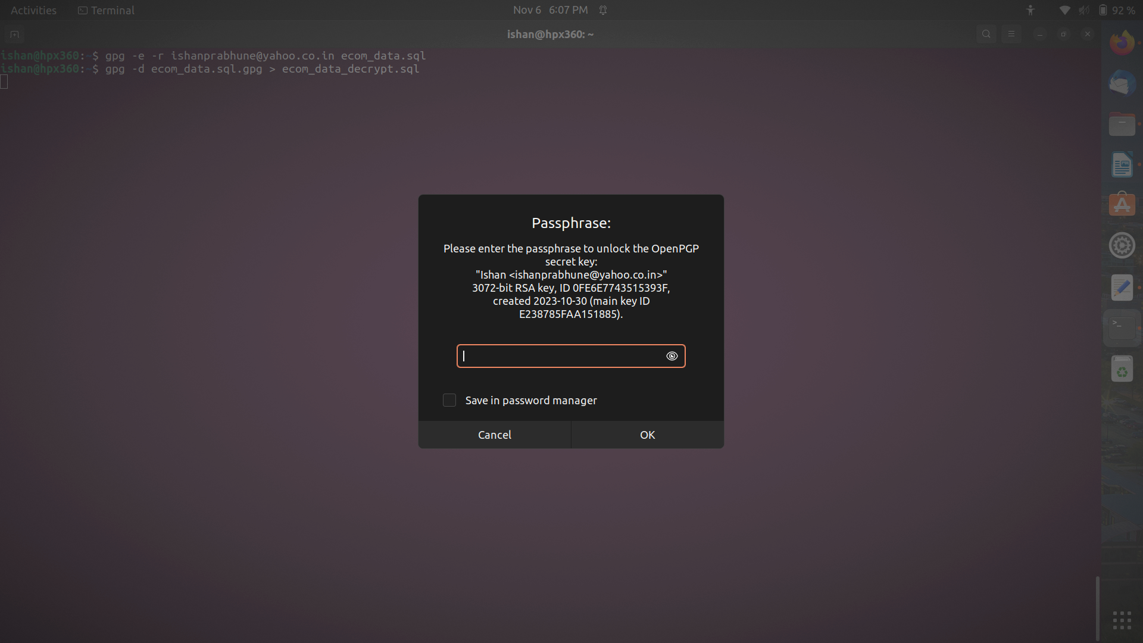
Procedure for decryption
The passphrase which above command will prompt.

Slide 20
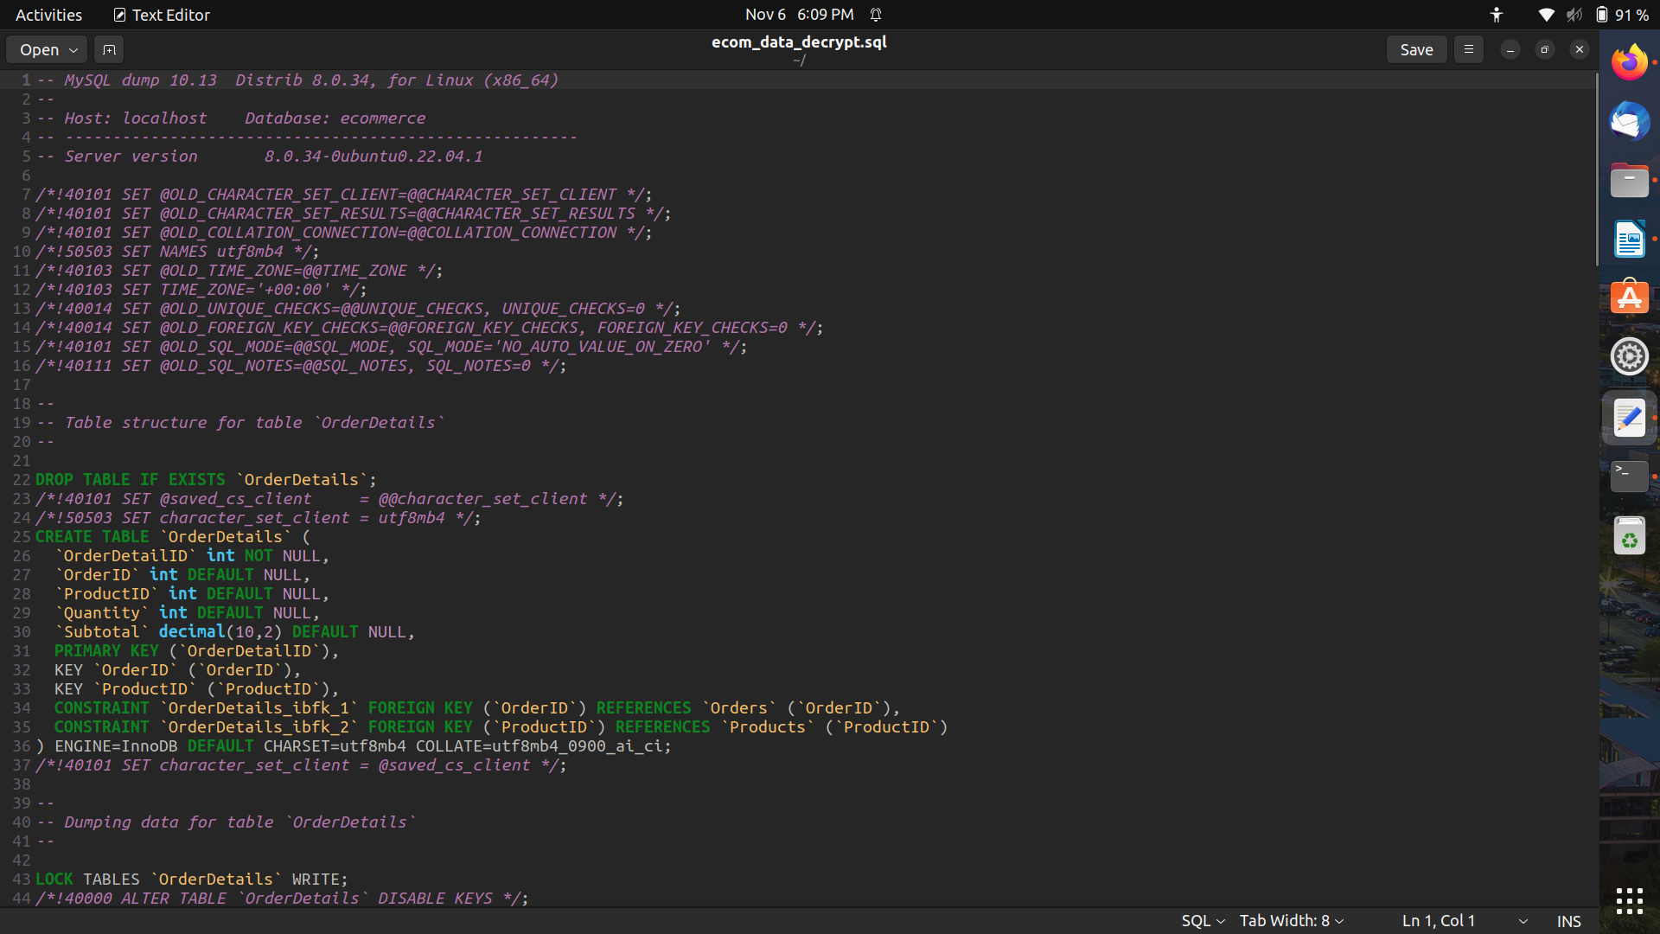
File DECRyption
The command and passphrase in before slide will help to decrypt the file.

Slide 21
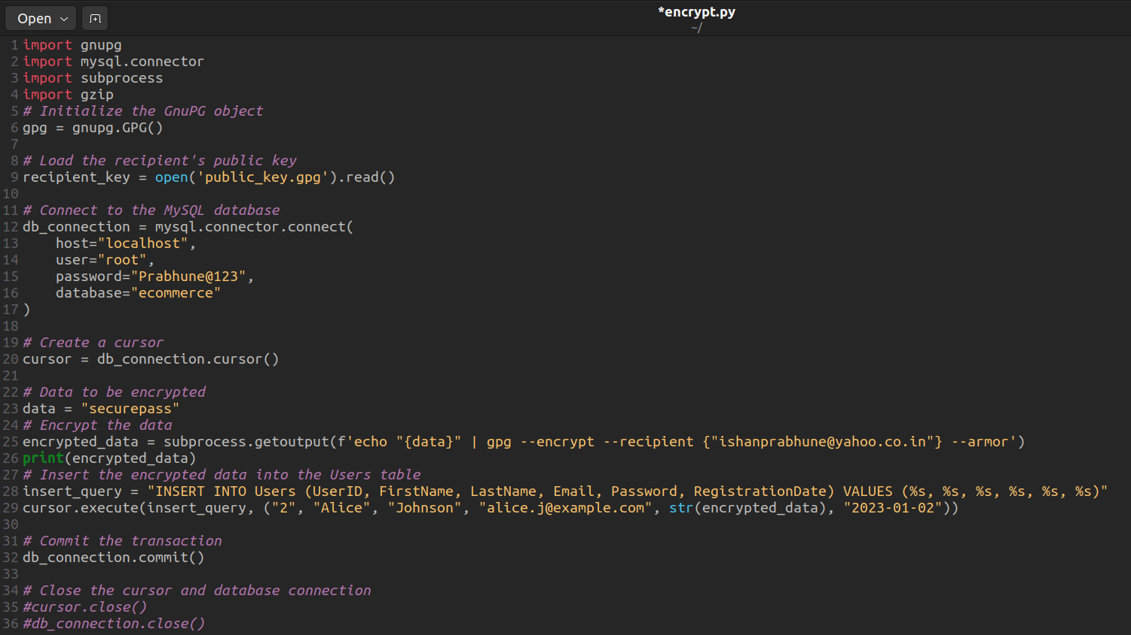
Procedure for encryption of single field in database
Python script to integrate GnuPG encryption into the database operations
This script will encrypt the password for UserID = 2 in the Users table.

Slide 22
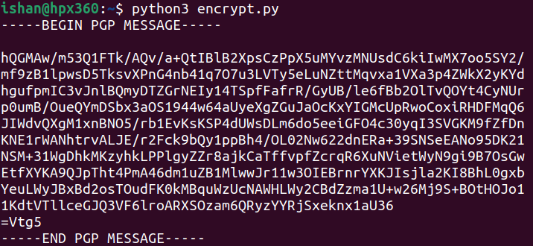
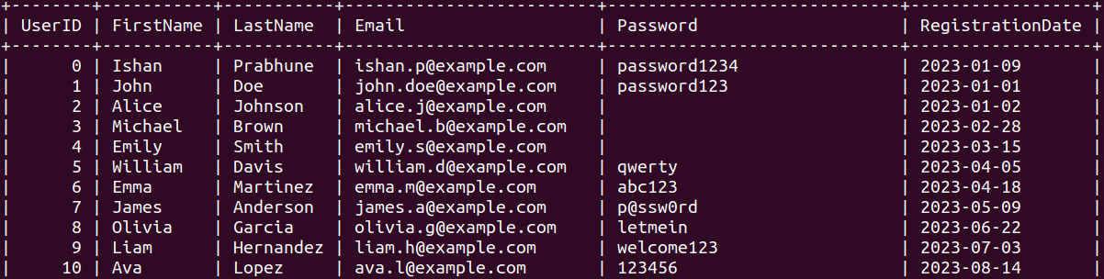
Procedure for encryption of single field
Running python script. This is the encrypted password.
Script has encypted the password data for UserID =2.
Data is not visible in the table as it is encrypted for UserID = 2.

Slide 23
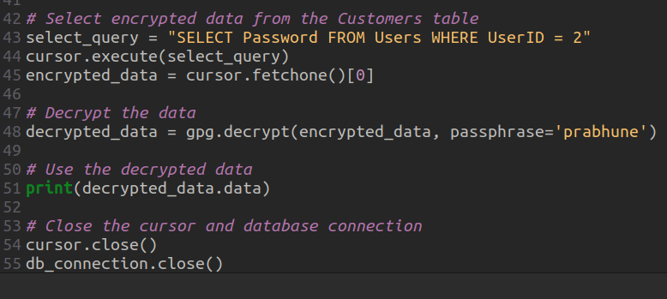
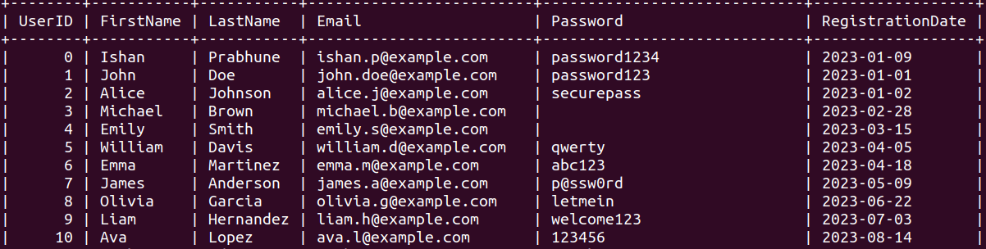
Script for decryption of Single field
Script for decrypting the password for userID=2 which was encrypted.
Script has decrypted the Password Data for UserID = 2

Slide 24
THANK YOU

